Slide 1
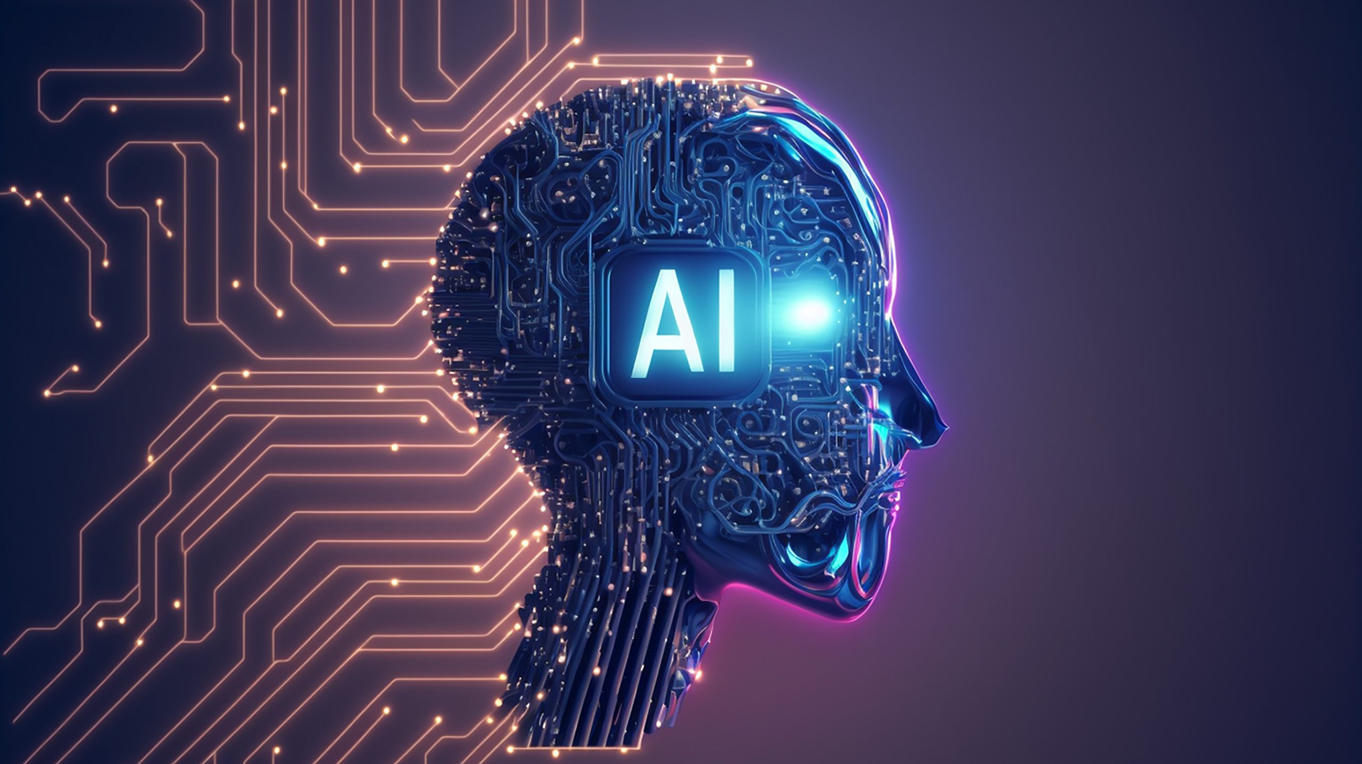

Slide 2
Benefits of AI in daily life
🔍 1. Improved Convenience
Smart Assistants: Tools like Siri, Alexa, and Google Assistant help with setting reminders, answering questions, controlling smart home devices, and more.
Smart Home Automation: AI controls lighting, thermostats, and security systems based on your habits.
⏱️ 2. Time and Effort Savings
Autocorrect and Predictive Text: Speeds up typing on phones and computers.
Navigation Apps: Google Maps and Waze use AI to suggest the fastest routes and predict traffic.
🛡️ 3. Enhanced Security
Fraud Detection: AI helps detect suspicious activity in banking or online transactions
Facial Recognition & Biometrics: Used for secure access to devices, apps, and buildings.

Slide 3
Graph

Slide 4
drawbacks and risks
1. Job Displacement
Automation of Tasks: AI and robots can replace jobs in manufacturing, customer service, data entry, and even some creative fields.
Skill Gaps: Workers may be unprepared for new job requirements, leading to unemployment or underemployment.
2. Privacy Concerns
Data Collection: AI systems often require large amounts of personal data, raising concerns about how it's collected, stored, and used.
Surveillance: Facial recognition and smart devices can be used for monitoring people without their consent.

Slide 5
3. Lack of Human Judgment
Poor Context Understanding: AI can misinterpret human language, emotion, or intent—leading to errors in communication or decision-making.
Over-Reliance: Depending too much on AI may weaken human skills and critical thinking.
4. Bias and Discrimination
Biased Algorithms: AI can inherit or amplify human biases from the data it's trained on, leading to unfair treatment in areas like hiring, lending, or law enforcement.
Lack of Transparency: It's often hard to understand why an AI system made a certain decision (“black box” problem).
5. Security Risks
Hacking AI Systems: Malicious actors can manipulate AI models (e.g., self-driving cars, voice assistants).
Deepfakes: AI-generated fake videos or audio can spread misinformation and erode trust.

